Slide 1
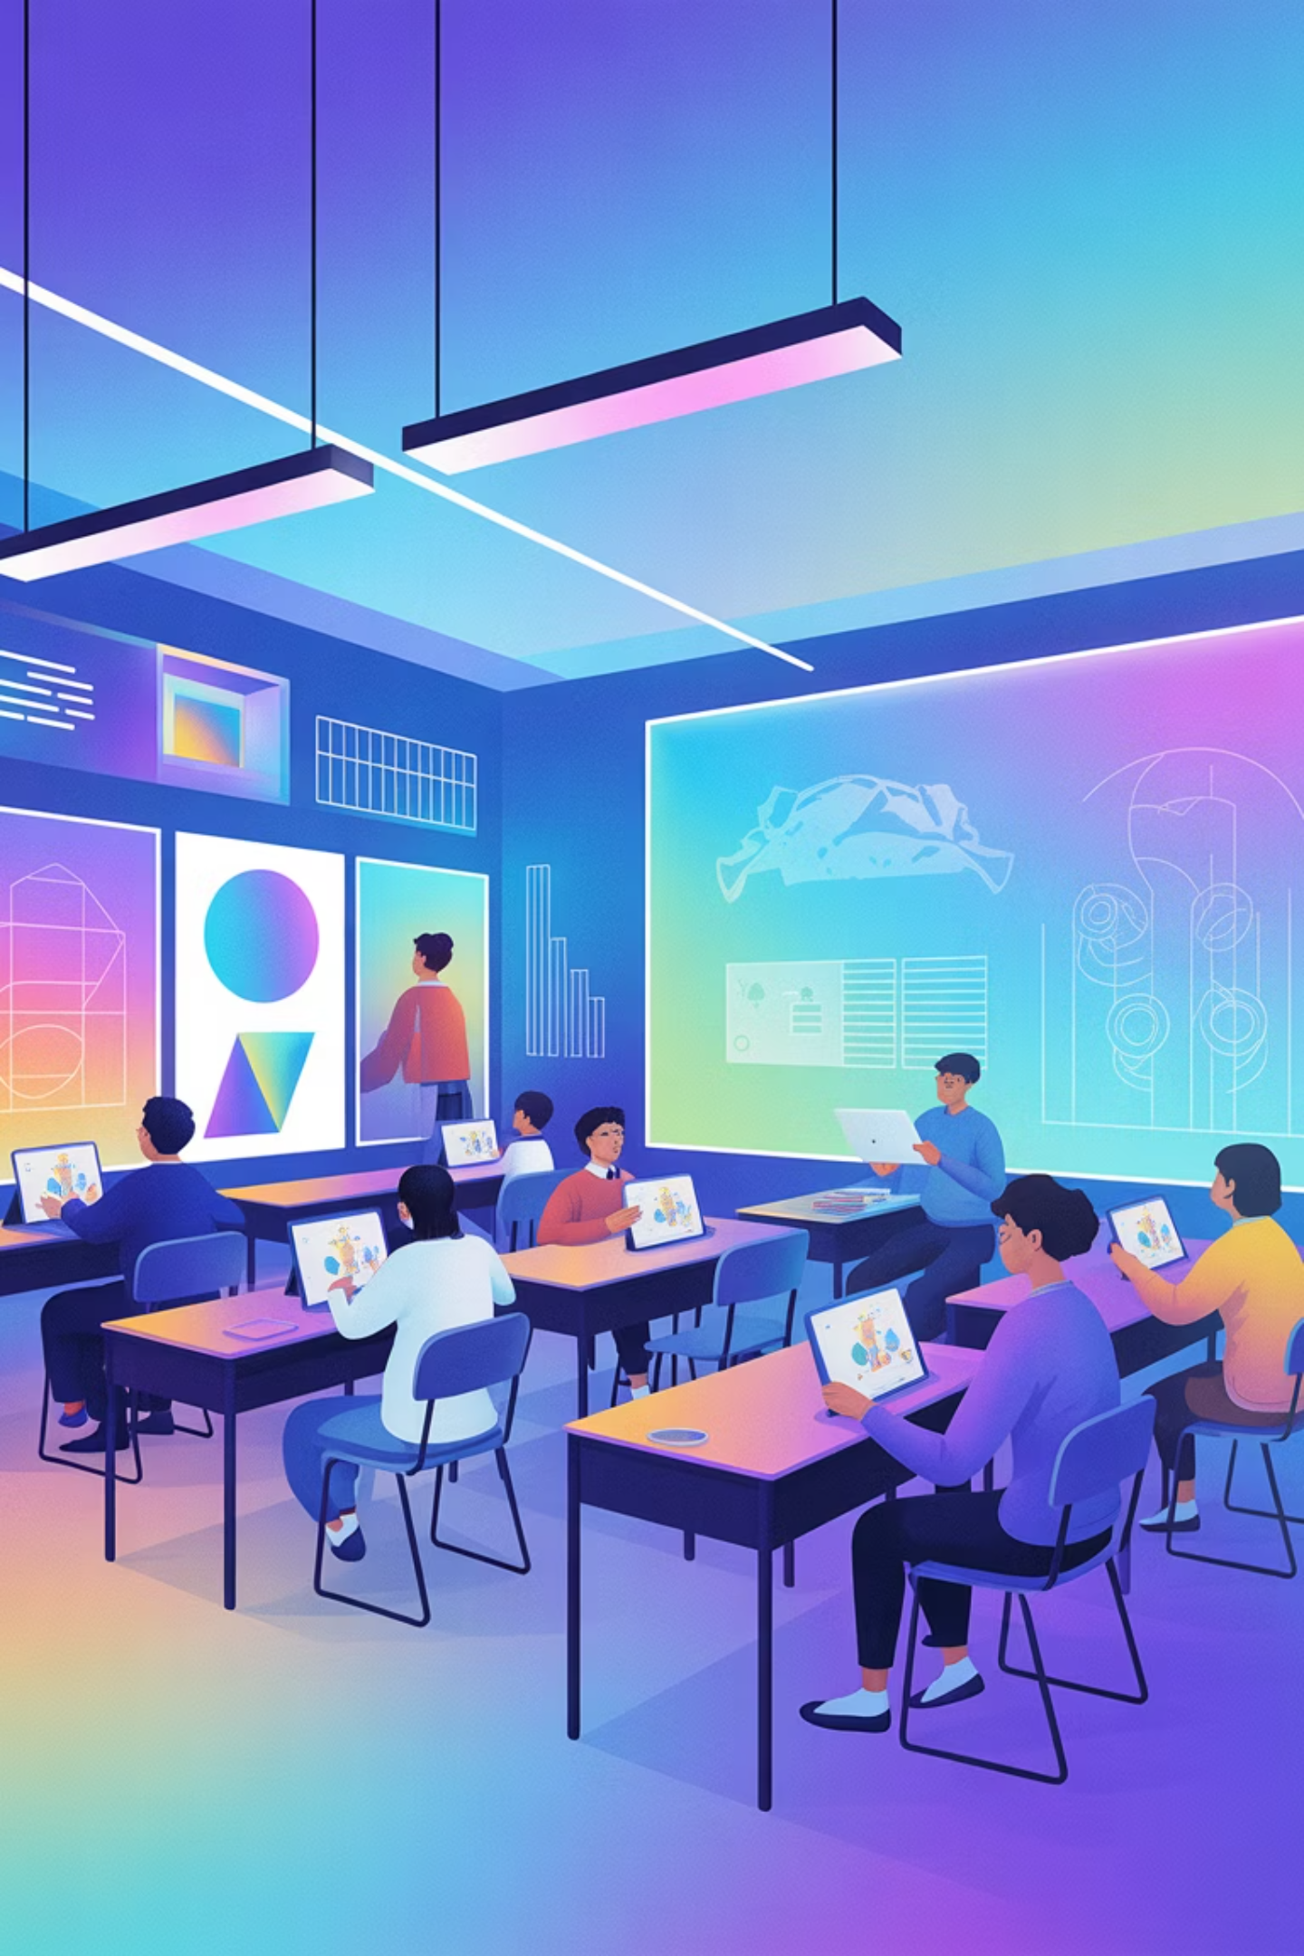
Unlocking Creativity: AI Image Generation & 3D Design in Education
Transforming teaching and learning through the power of artificial intelligence and three-dimensional design tools

Slide 2


FOUNDATION
What is AI-Based Image Generation?
AI image generators harness the power of machine learning algorithms trained on millions of images to create stunning visuals from simple text prompts. Tools like Microsoft Designer, DALL·E 3, and Bing Image Creator democratize visual content creation, enabling educators to produce custom, copyright-free images instantly.
This revolutionary technology bridges the gap between abstract concepts and concrete visuals, transforming how students understand and engage with learning material while fostering creativity across all subject areas.

Slide 3
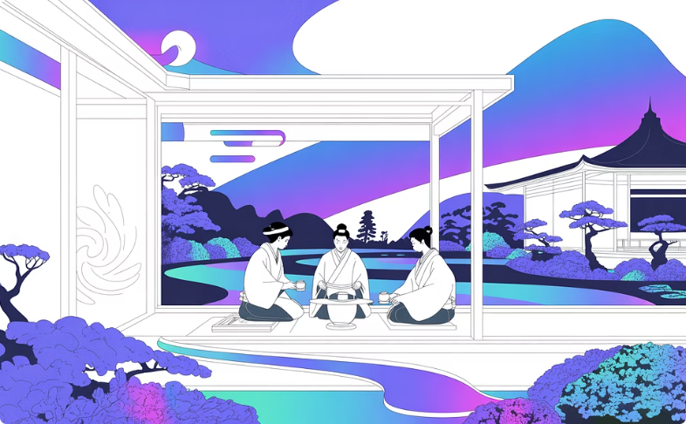
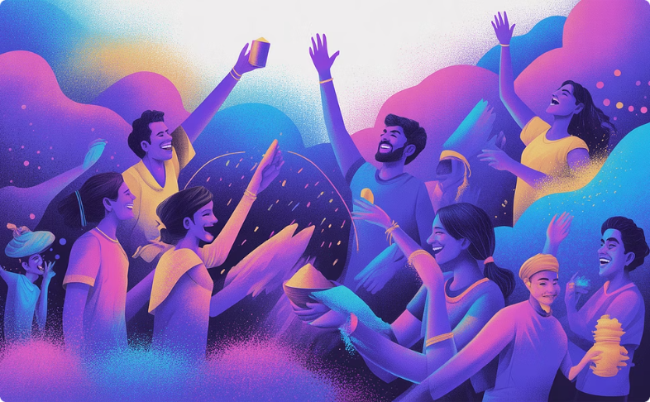
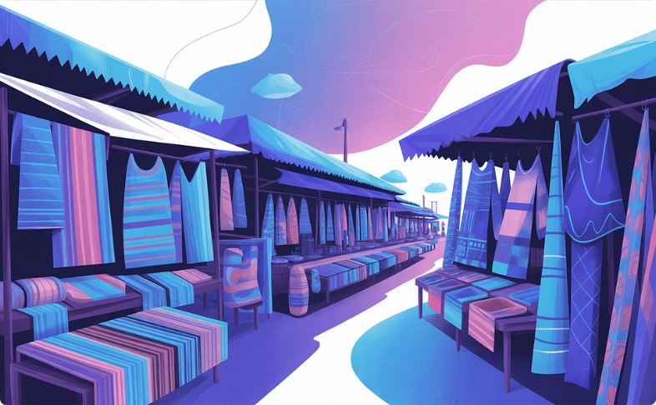
Using Bing Image Creator for Culture-Themed Visuals
Cultural Authenticity
Global Perspectives
Instant Creation
Bing Image Creator leverages DALL·E 3 to generate culturally rich, accurate images from detailed text descriptions.
Bring diverse cultural contexts alive visually, supporting global awareness and fostering inclusive classrooms.
Generate custom visuals in seconds, eliminating the need for extensive image searches or licensing concerns.

Slide 4
TECHNIQUE
The Prompt Writing Process: Crafting Effective Descriptions
01
02
Be Specific and Detailed
Use Descriptive Language
Include the subject, artistic style, mood, setting, and key details. Example: "vibrant 1920s Harlem jazz club with musicians on stage, art deco style, warm golden lighting"
Employ rich adjectives and reference specific artistic movements or photographers to guide the AI's interpretation and output quality.
03
04
Experiment and Iterate
Leverage AI Assistance
Generate multiple variations by adjusting your prompts. Each attempt refines your understanding of what works best for your educational goals.
Use tools like ChatGPT or Bing Copilot to brainstorm creative prompt ideas and expand your descriptive vocabulary for better results.

Slide 5
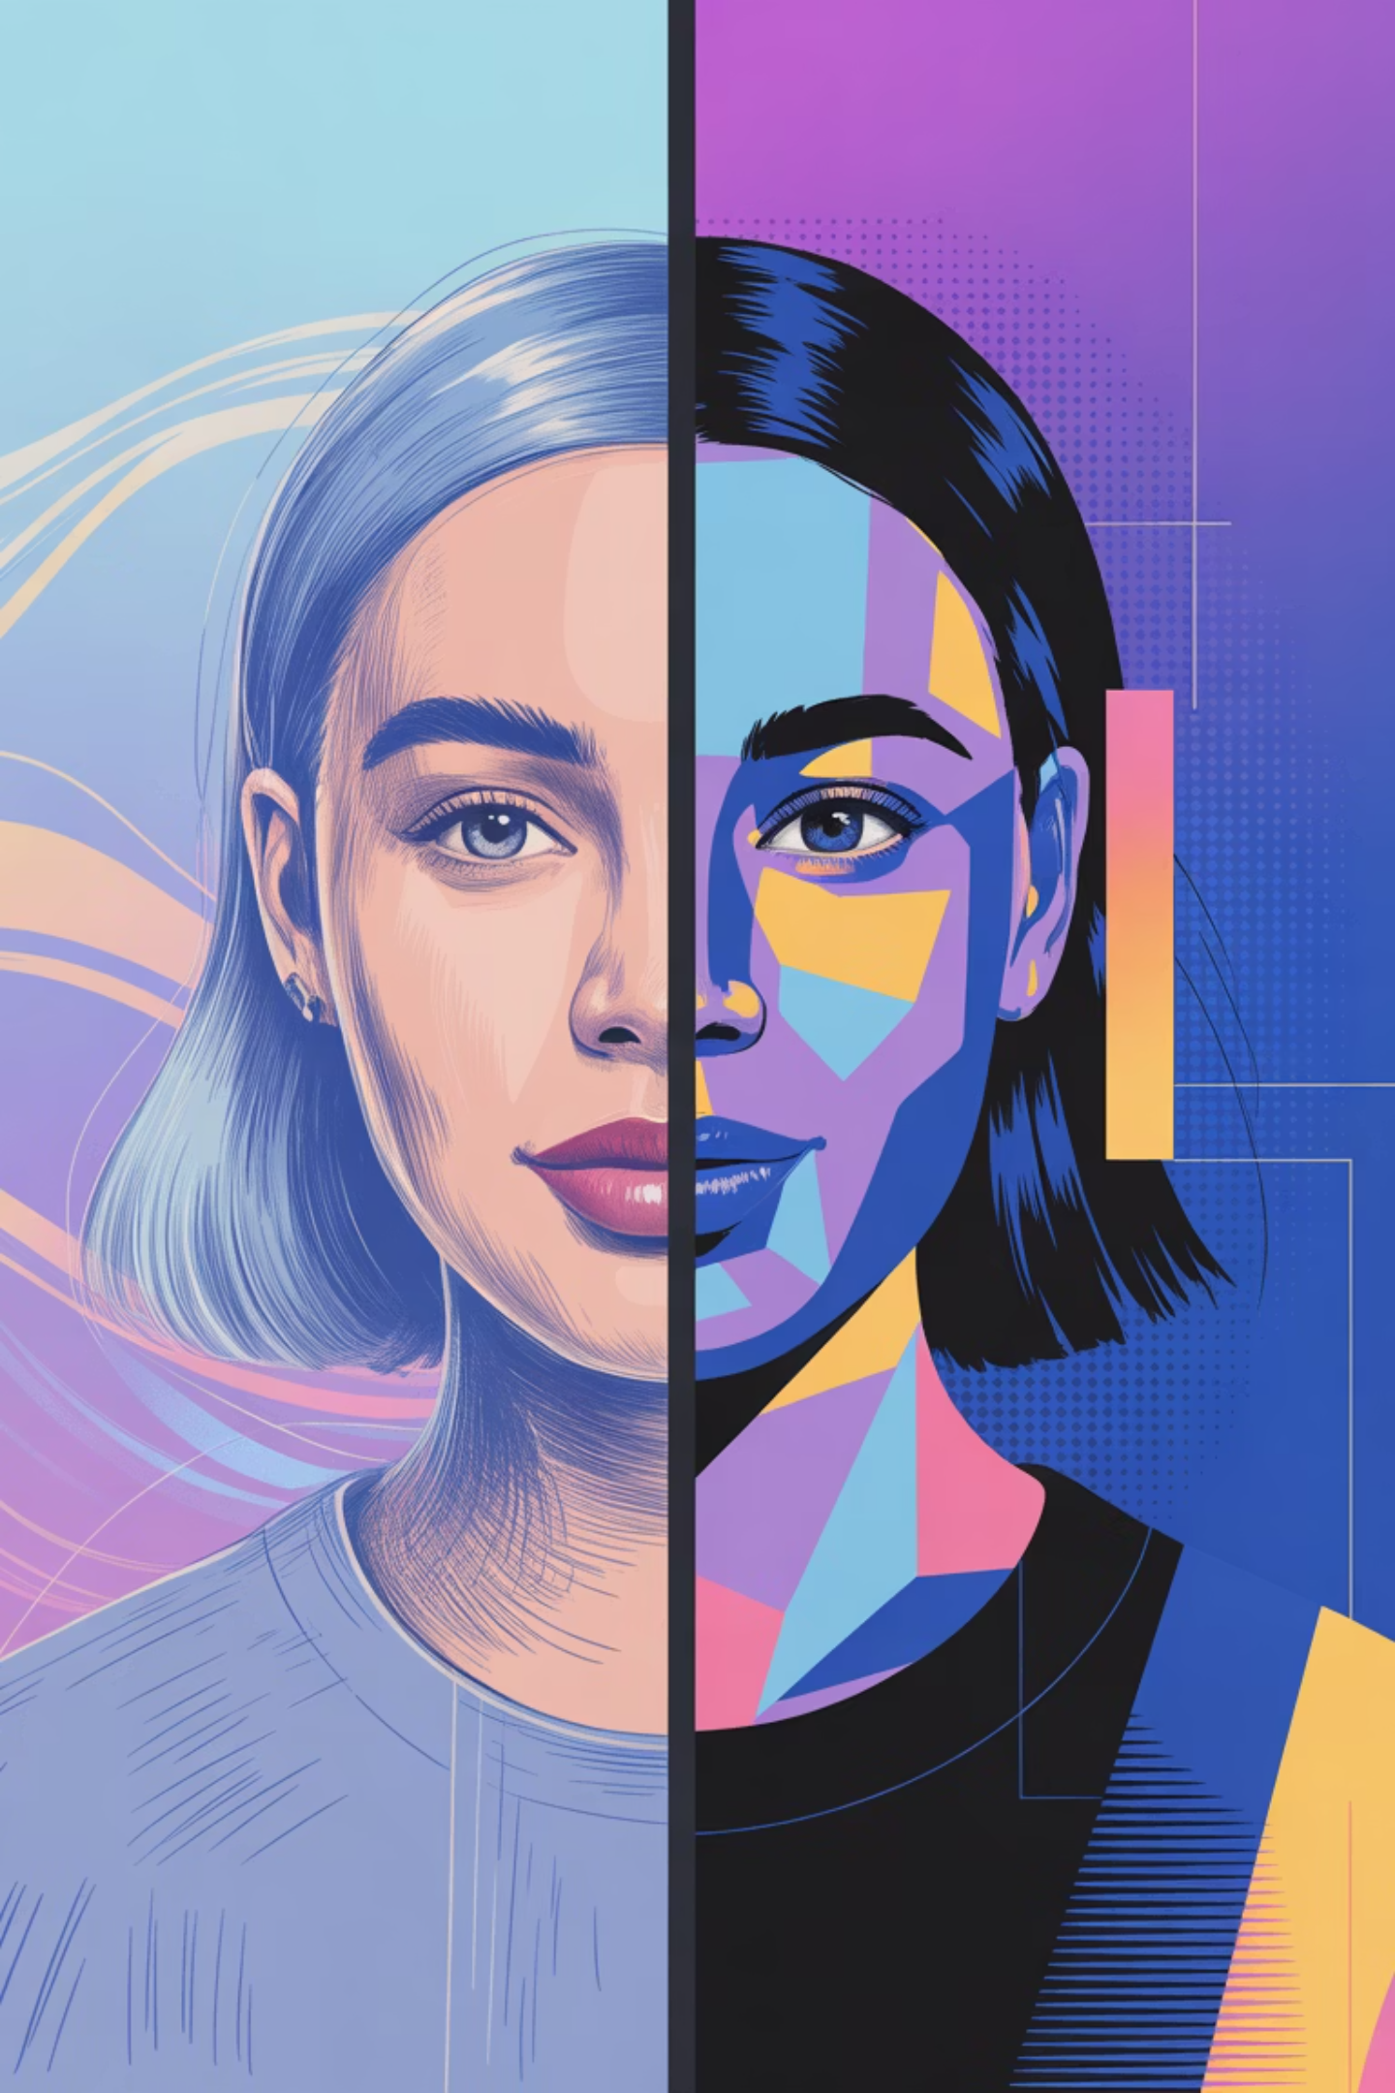
Exploring Art Styles in AI-Generated Images
Cubism
Impressionism
Photorealism
Abstract, geometric forms perfect for creative thinking exercises
Soft, painterly visuals ideal for literature and emotion-based lessons
Lifelike images for science, history, and factual presentations
Digital Illustration
Modern, vibrant graphics that resonate with digital-native students
Your choice of art style profoundly impacts student engagement and lesson tone. Example: "Cubism style purple cows on a pink mountain" creates whimsical, abstract visuals that spark imagination and discussion. Select styles that align with your learning objectives and audience.

Slide 6
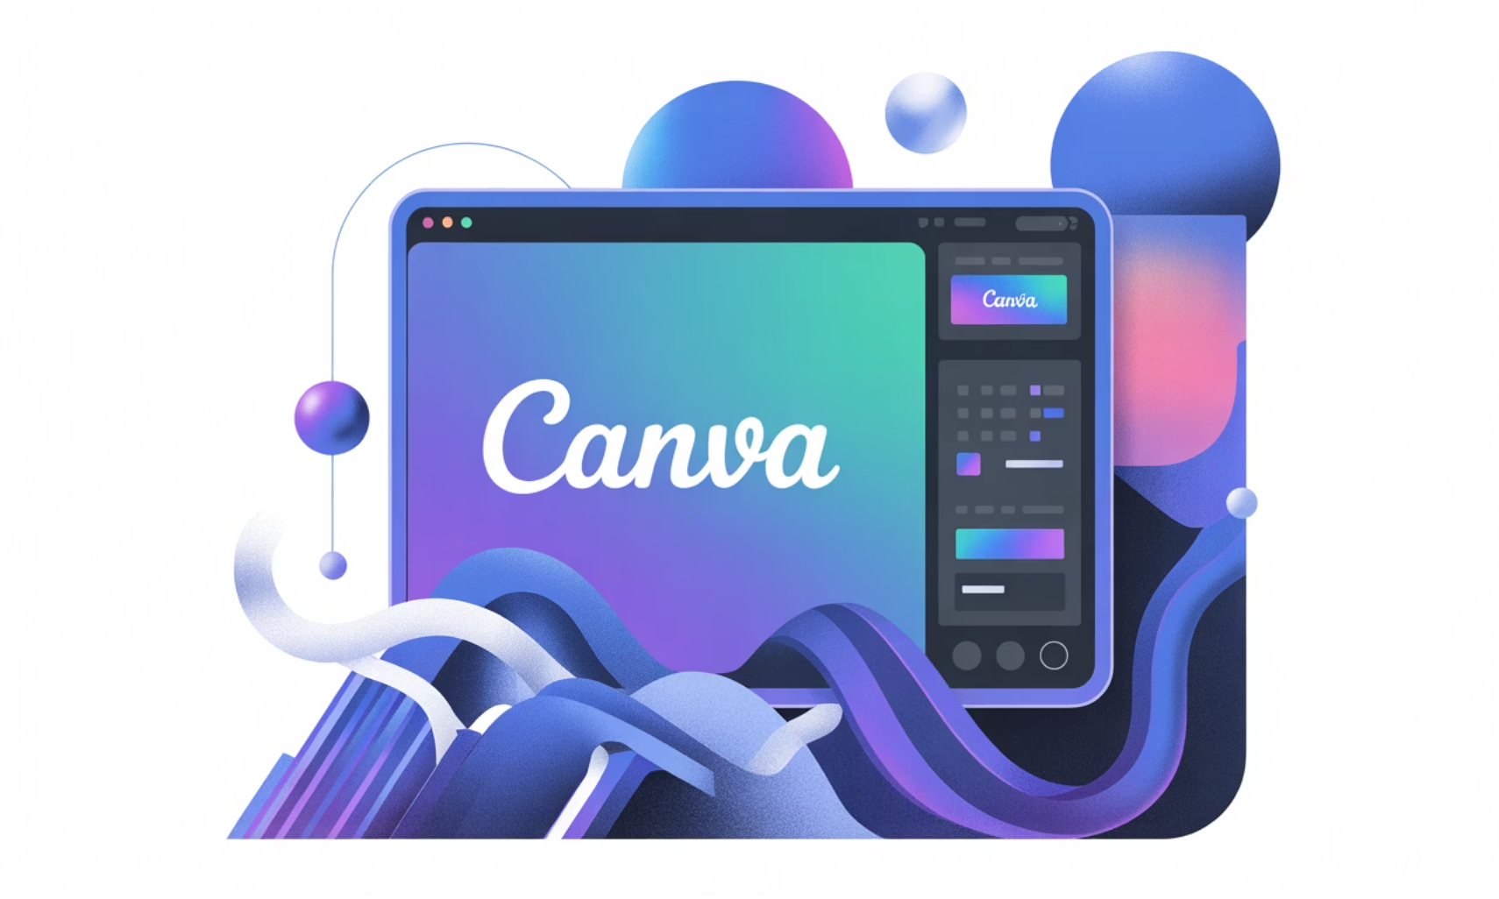
Creating 3D-Style Designs with Canva 3D
User-Friendly Interface
Canva 3D offers intuitive drag-and-drop tools that make dimensional design accessible to educators without technical expertise.
Depth & Dimension
Add professional touches like shadows, layers, perspective effects, and depth to transform flat images into dynamic visuals.
Classroom Ready
Create eye-catching posters, interactive displays, and digital presentations that command student attention and enhance learning spaces.
Transform your teaching materials: Take a flat AI-generated cultural scene and elevate it into a stunning 3D poster that brings historical moments or geographical concepts to life on your classroom walls.

Slide 7

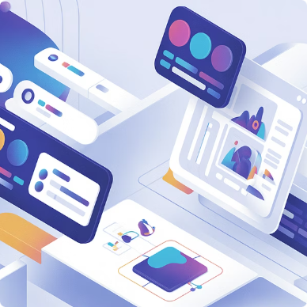
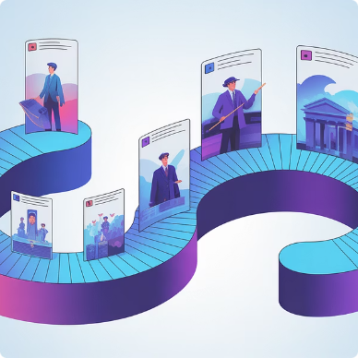
INTEGRATION
Combining AI-Generated Images with 3D Elements: A Visual Fusion
Layering Techniques
Interactive Content
Immersive Learning
Stack AI-generated images with 3D elements to create depth, highlight key concepts, and guide visual attention toward learning objectives.
Develop engaging digital materials where students can explore concepts through clickable, multi-dimensional visual experiences.
Example application: Design a 3D timeline where AI-generated historical scenes leap forward, creating memorable connections to past events.

Slide 8
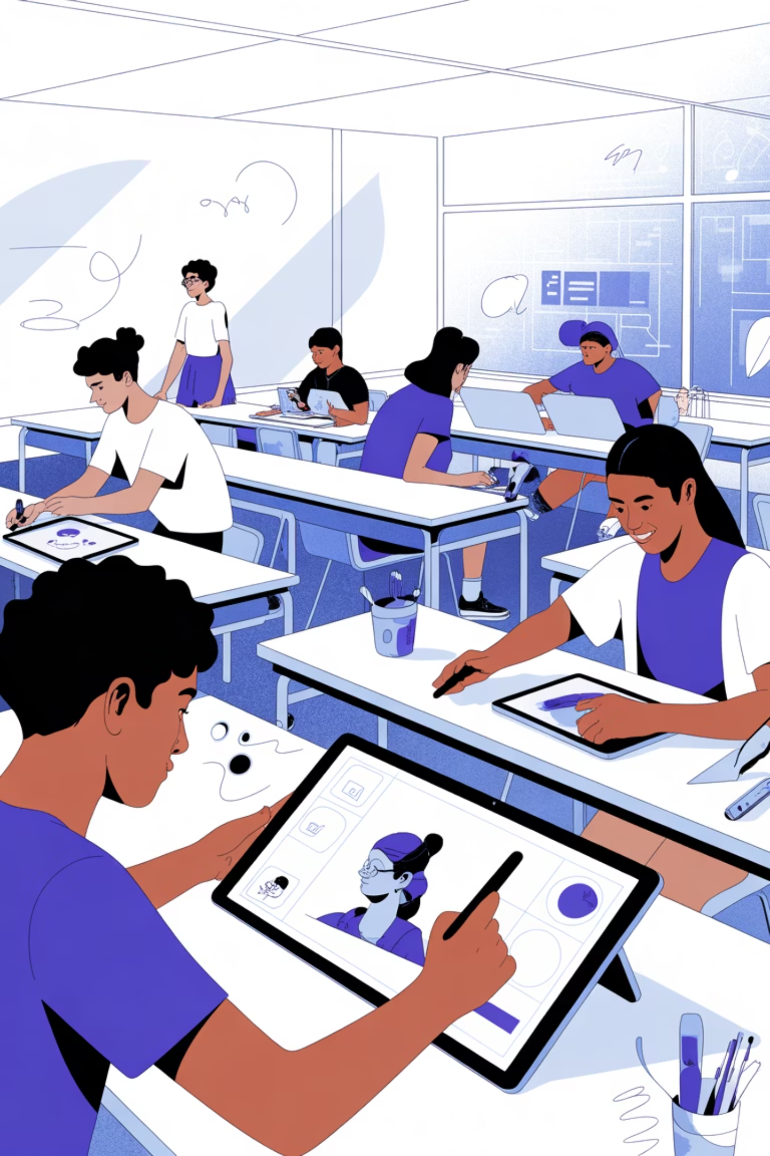




Examples of Student Activities Using AI & 3D Visuals
Creative Writing Enhancement
Art Style Exploration
Cultural Presentations
Learners create and modify AI images across different artistic movements, analyzing how style affects mood and meaning.
Collaborative projects combining AI-generated cultural visuals with 3D Canva designs for rich, multimedia presentations.
Students generate AI images as story prompts, then write narratives inspired by the visuals, developing both creative and technical skills.
Visual Vocabulary
Custom AI-generated flashcards with context-rich imagery that enhances memory retention and language acquisition.

Slide 9
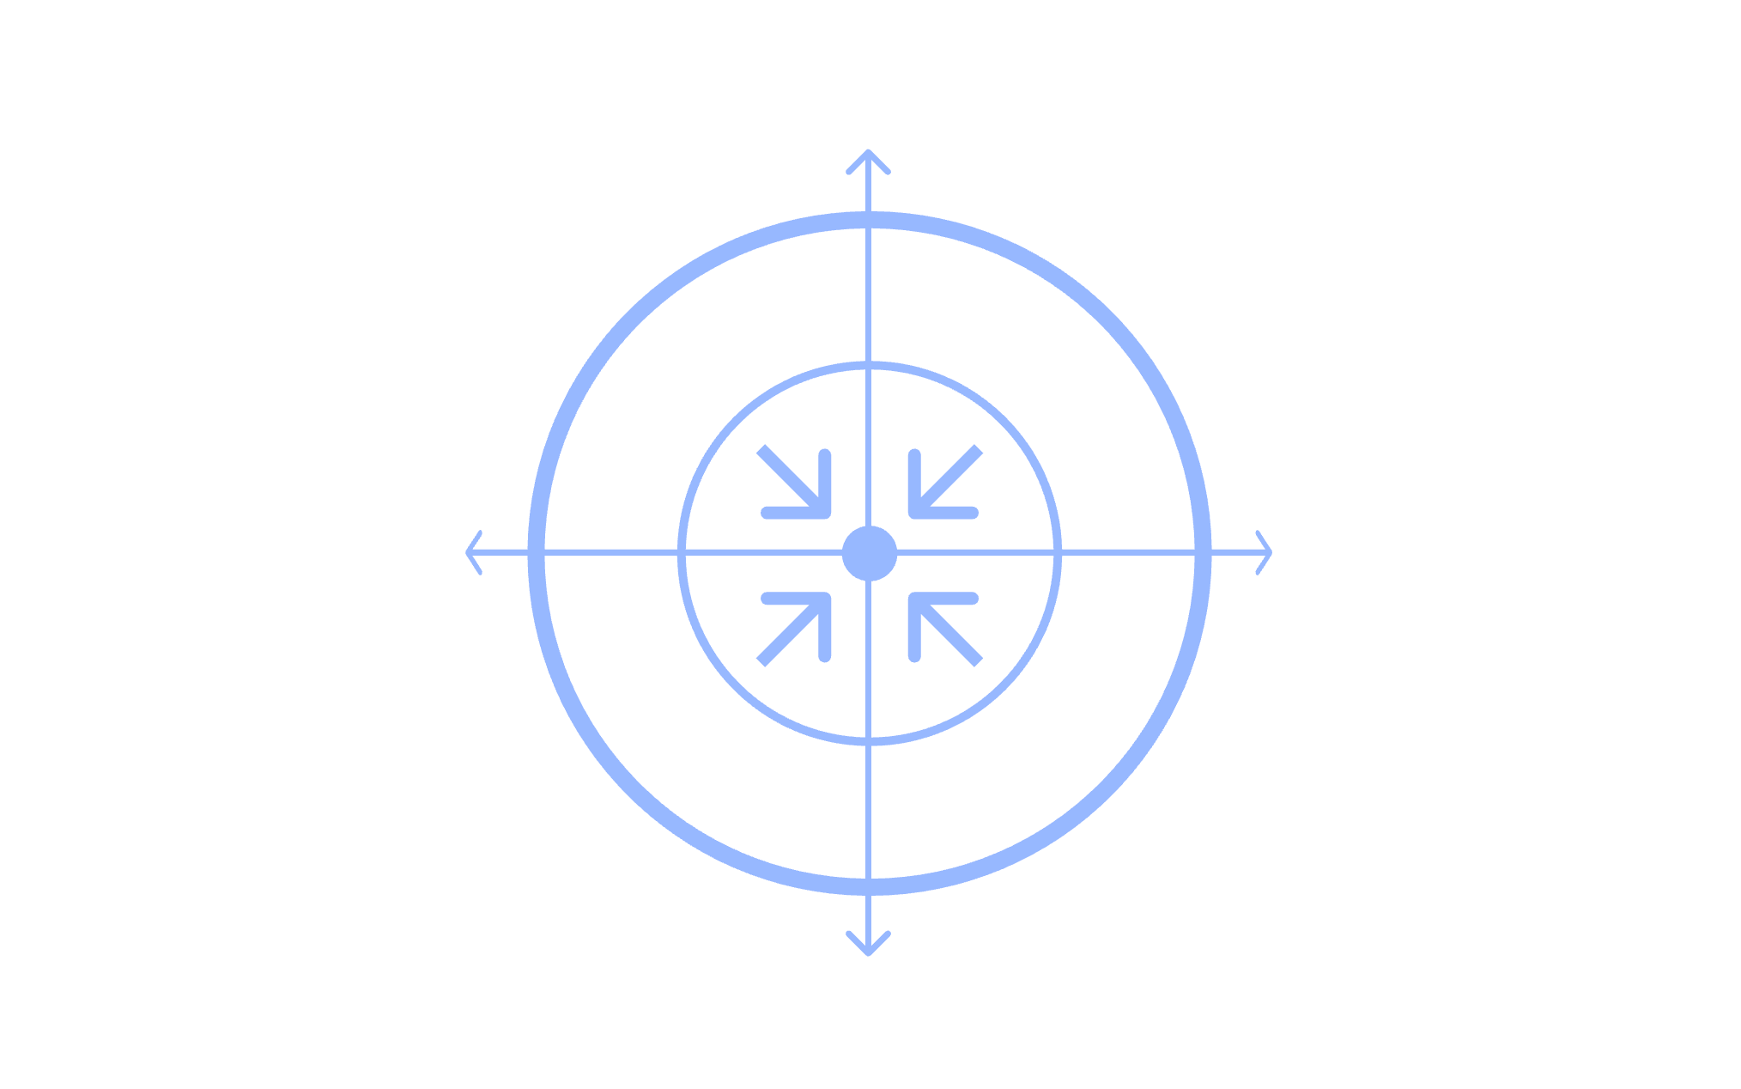
Integrating AI Image Generation into Lessons & Learning Outcomes
Multimodal Learning
Measurable Impact
Supports multimodal learning through visual, linguistic, and creative skill development
Encourages student agency by involving learners in prompt creation and image curation
Enhances engagement and critical thinking through visual exploration and analysis
Saves valuable teacher time, enabling focus on differentiated instruction and personalized support
Teacher Efficiency
Student Agency
Enhanced Engagement
Students develop crucial 21st-century skills including digital literacy, cultural awareness, and creative problem-solving.
The integration creates a powerful feedback loop where technology amplifies pedagogy and student creativity flourishes.

Slide 10
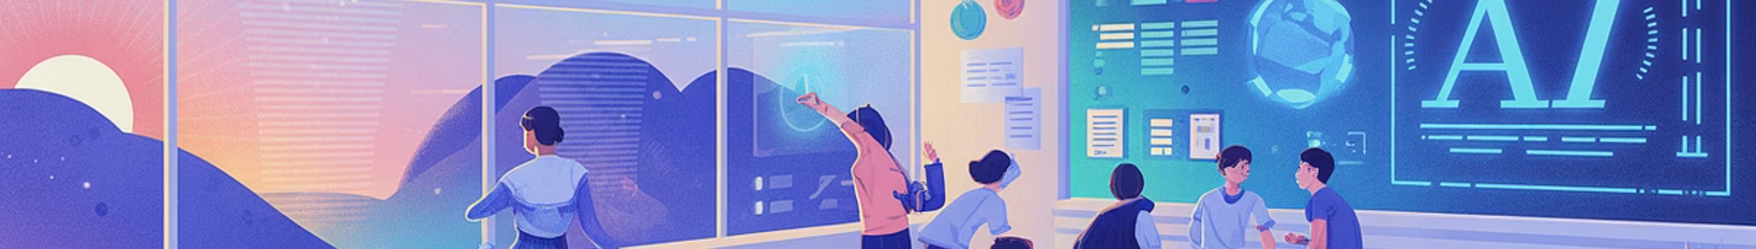



Embrace the Future: Empower Learning with AI & 3D Creativity
Unlock New Possibilities
Start Experimenting Today
Inspire Student Creators
AI image generation and 3D design tools open doors to teaching approaches previously impossible or impractical.
Begin with simple projects to create vibrant, inclusive, and interactive lessons that captivate your students.
Transform learners from passive consumers into active creators of meaningful digital content and visual narratives.
Together, let's transform education with the power of AI-driven visual storytelling. The future of learning is creative, inclusive, and powered by technology that amplifies human imagination.

